Slide 1

Previously On...
Voltage, Current and Resistance
Inputs and Outputs
Digital Vs. Analog
Commands
pinMode(pin, INPUT/OUTPUT);
digitalWrite(pin, HIGH/LOW);
delay(ms);
analogWrite(pin, 0-255);
Functions
void setup() {}
void loop() {}
Comments
// Keep things clear
Variables
int led = 9;
int brightness = brightness + 1;

Slide 2
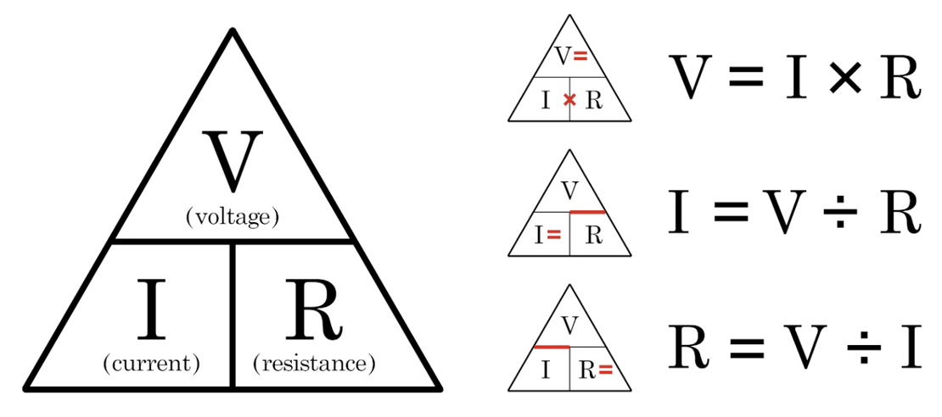
Ohm’s Law

Slide 3
Previously On...
Voltage, Current and Resistance
Inputs and Outputs
Digital Vs. Analog
Commands
pinMode(pin, INPUT/OUTPUT);
digitalWrite(pin, HIGH/LOW);
delay(ms);
analogWrite(pin, 0-255);
Functions
void setup() {}
void loop() {}
Comments
// Keep things clear
Variables
int led = 9;
int brightness = brightness + 1;

Slide 4

The Most Important Lesson
Notes:
This is why there’s a diversity problem in Engineering

Slide 5
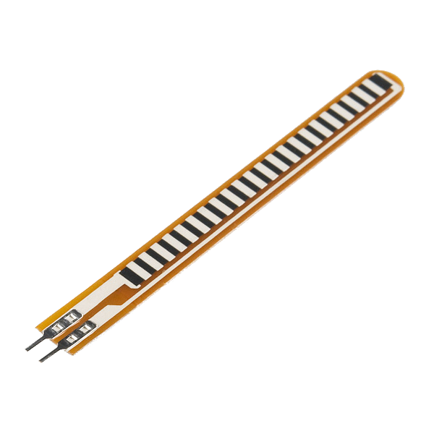
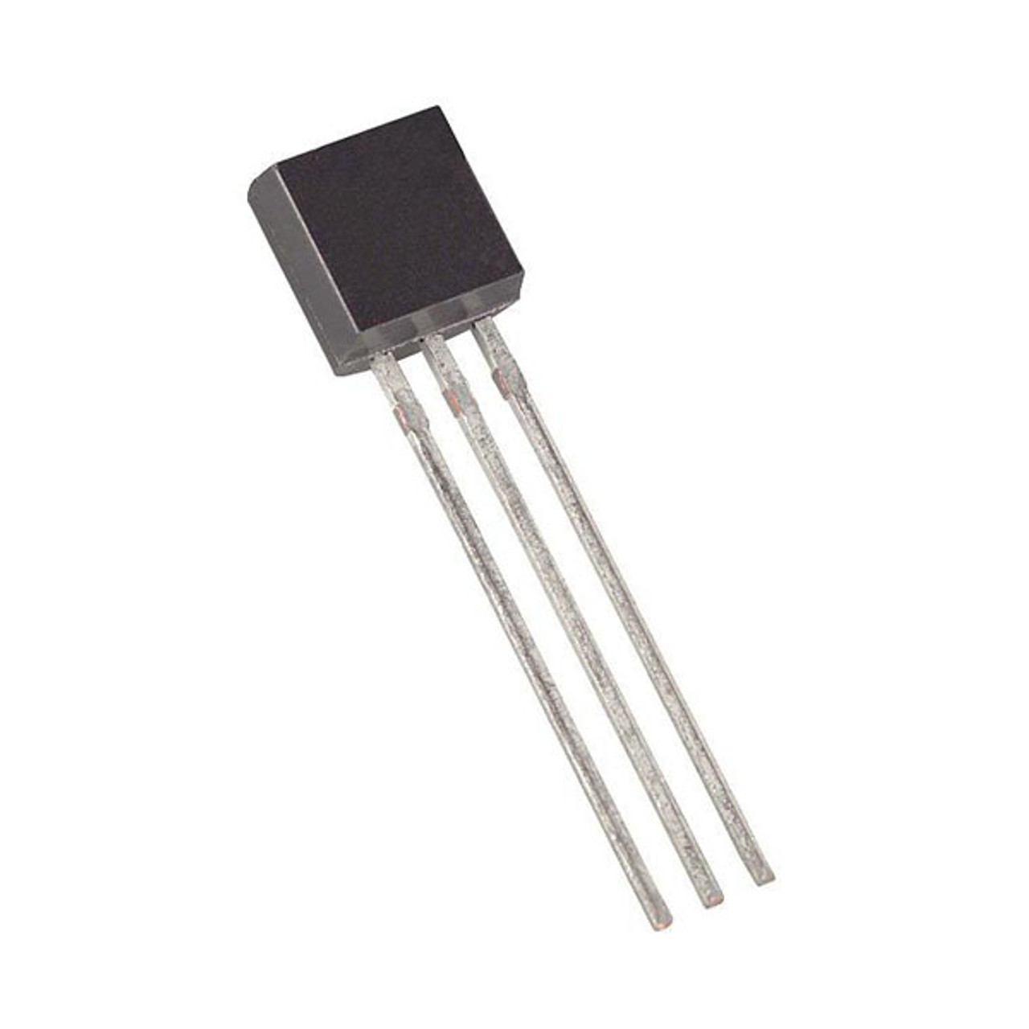

Inputs!
Input is any signal entering an electrical system
Both digital and analog sensors are forms of input
Input can also take many other forms: a keyboard, a mouse, infrared sensors, biometric sensors, touch sensors or just plain voltage from a circuit
This is what makes interactive exhibits interactive

Slide 6
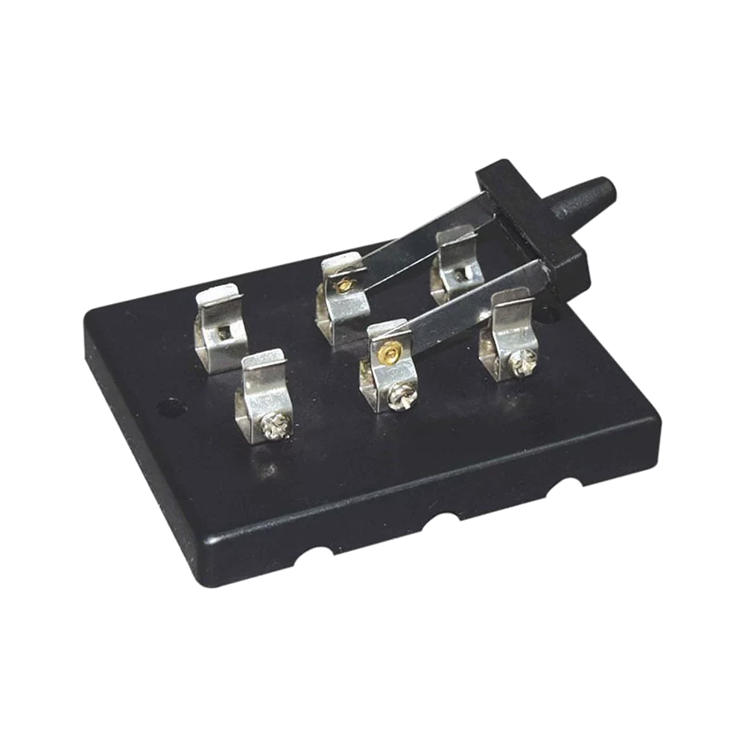
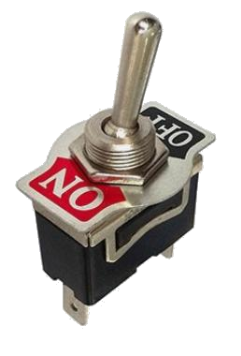
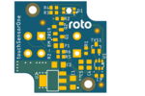
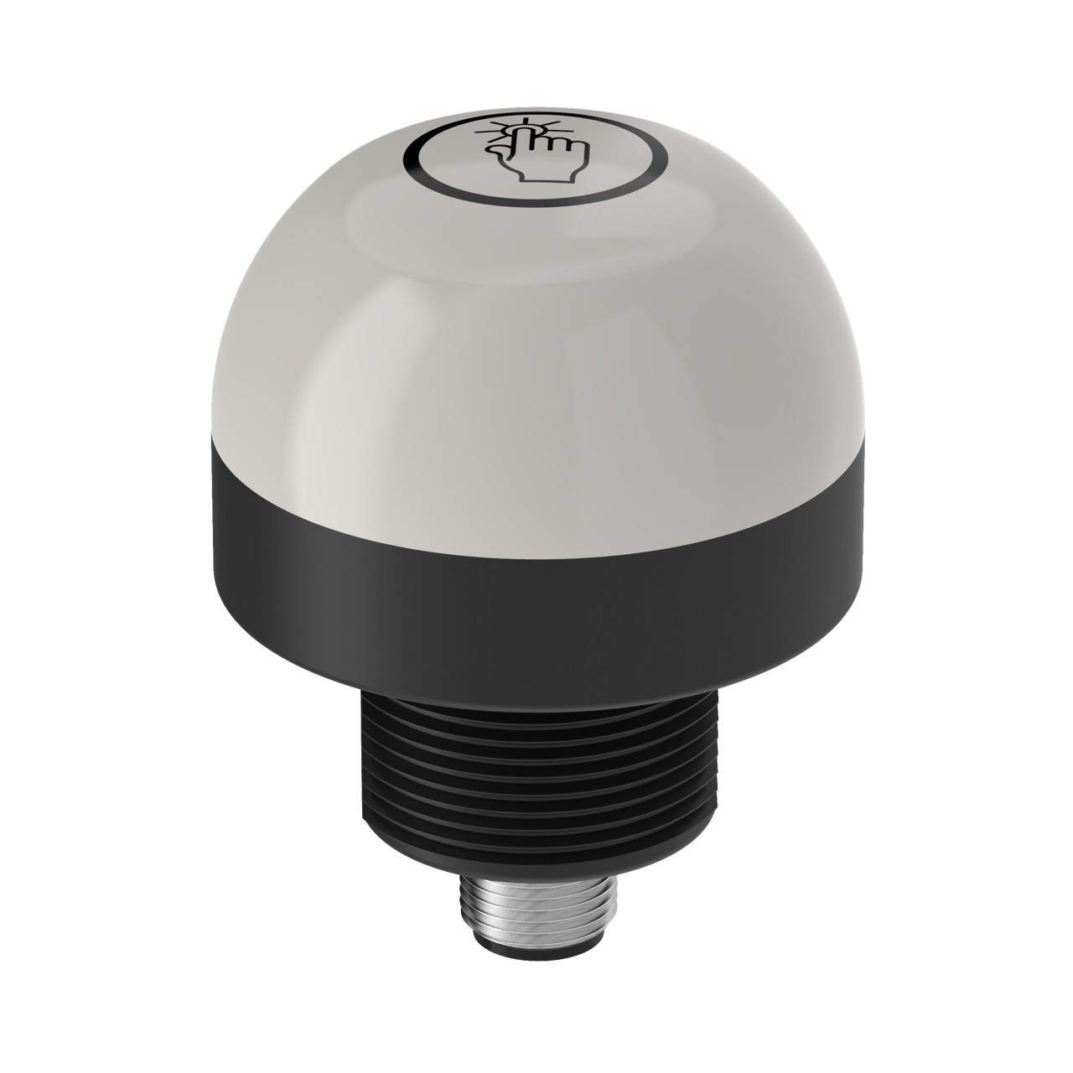
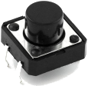
Digital Input
Like digital output, can only sense if a signal is high or low
For Arduino
High is voltage above 3 V
Low is voltage below 1.5 V
General category is “switches”
Includes push buttons (momentary switches), toggle switches, knife switches (maintained switches), capacitive/touch switches, and many other sensors

Slide 7
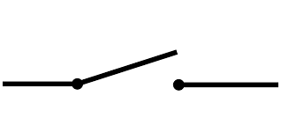
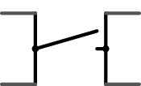
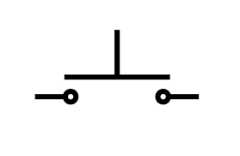
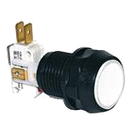
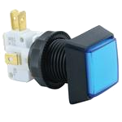
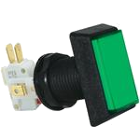
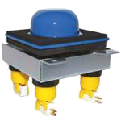
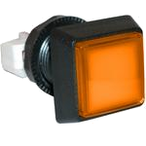
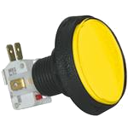
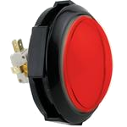
Component Spotlight: The Push Button / Momentary Switch

Slide 8
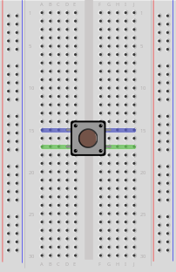
Push Button and Breadboard Connections
Our buttons have to bridge the gap on our breadboards
The top pins are connected to each other and so are the bottom ones

Slide 9
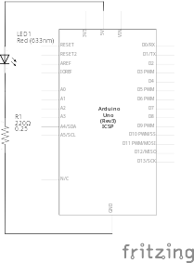
Using the Breadboard to Built a Simple Input Circuit
Remember our original circuit?

Slide 10
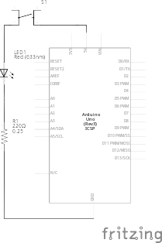
Using the Breadboard to Built a Simple Input Circuit
Remember our original circuit?
We’re going to wire that up again, but this time with a switch

Slide 11
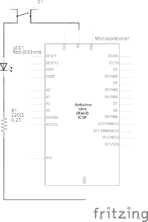
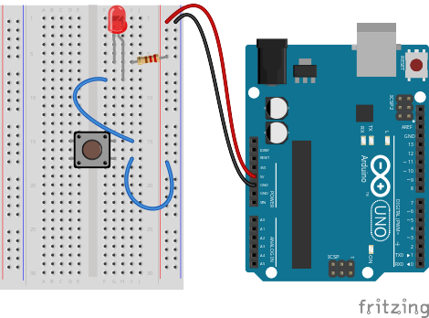
Using the Breadboard to Built a Simple Input Circuit

Slide 12

Using the Breadboard to Built a Simple Input Circuit

Slide 13
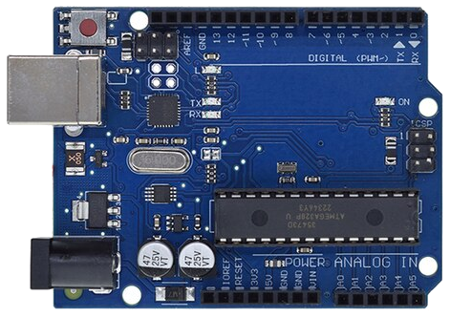
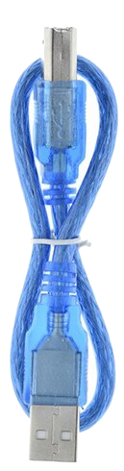

Go ahead and plug your board in!

Slide 14

Adding Control

Slide 15
Adding Control
Any circuit that has meaningful input has some degree of control

Slide 16
Adding Control
Any circuit that has meaningful input has some degree of control
Microcontrollers allow us to assign different relationships between inputs and outputs

Slide 17
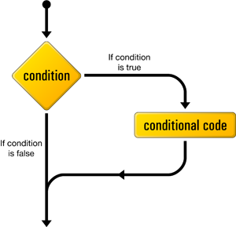
if() statements / Boolean logic
Project #3 – Lie Detector
Just give me 3 clock cycles with the bastard
Psuedo-code – how should this work?
Green LED turns on
Statement true?
YES
NO
Red LED turns on

Slide 18
Project #3 – Lie Detector Inputs and Outputs
Green LED turns on
Statement true?
YES
NO
Red LED turns on
Inputs | Outputs
None | Green LED
 | Red LED
Notes:
Our program is running hundreds of thousands of times every second

Slide 19
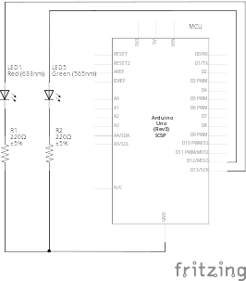
Project #3 – Lie Detector Schematic
You can leave the button on the breadboard- we’ll be using it again soon

Slide 20
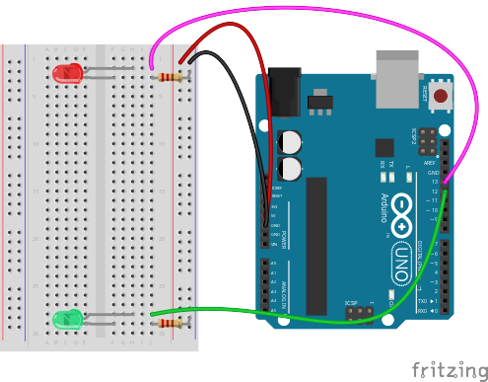
Project #3 – Lie Detector Wiring Diagram

Slide 21
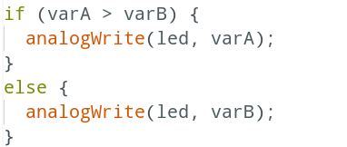
Project #3 – Lie Detector Conditional Statements
the if() statement

Slide 22
Project #3 – Lie Detector Conditional Statements
If this is true

Slide 23
Project #3 – Lie Detector Conditional Statements
If this is true
Do this

Slide 24
Project #3 – Lie Detector Conditional Statements
If this is true
Do this
Otherwise

Slide 25
Project #3 – Lie Detector Conditional Statements
If this is true
Do this
Otherwise
Do this

Slide 26
Boolean Operators
<Boolean> | True if:
(a) | a is true, HIGH or does not equal zero
(!a) | a is false, LOW or equals zero
(a) == (b) | a is equal to b
(a) != (b) | a is not equal to b
(a) > (b) | a is greater than b
(a) >= (b) | a is greater than or equal to b
(a) < (b) | a is less than b
(a) <= (b) | a is less than or equal to b
(a) && (b) | both a is true AND b is true
(a) || (b) | either a is true OR b is true

Slide 27
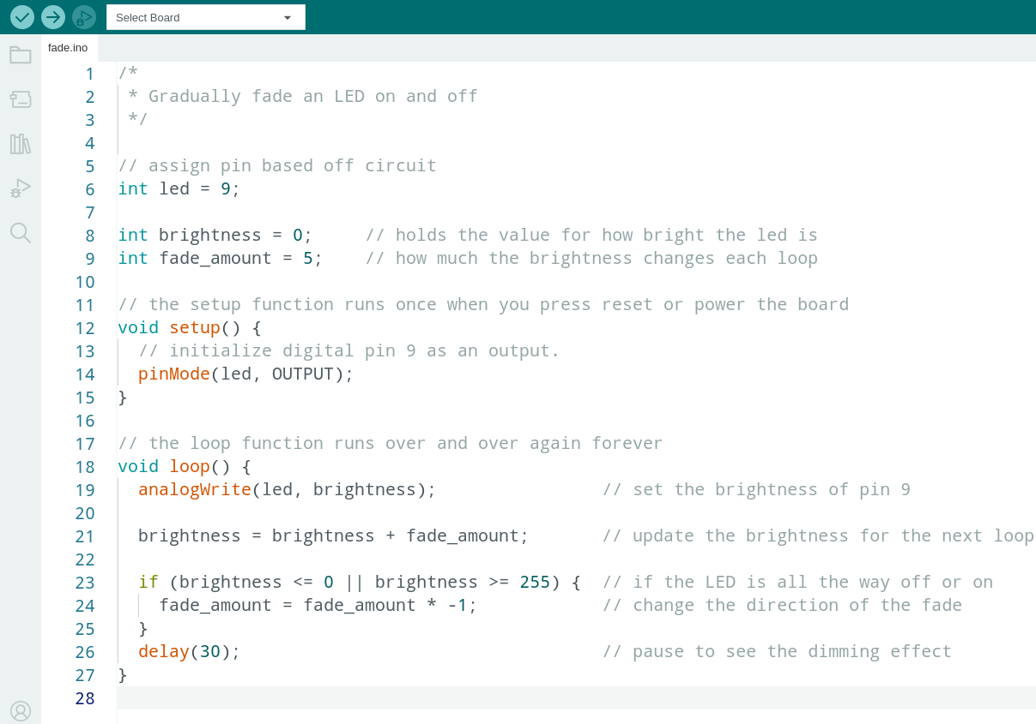
Déjà Vu

Slide 28
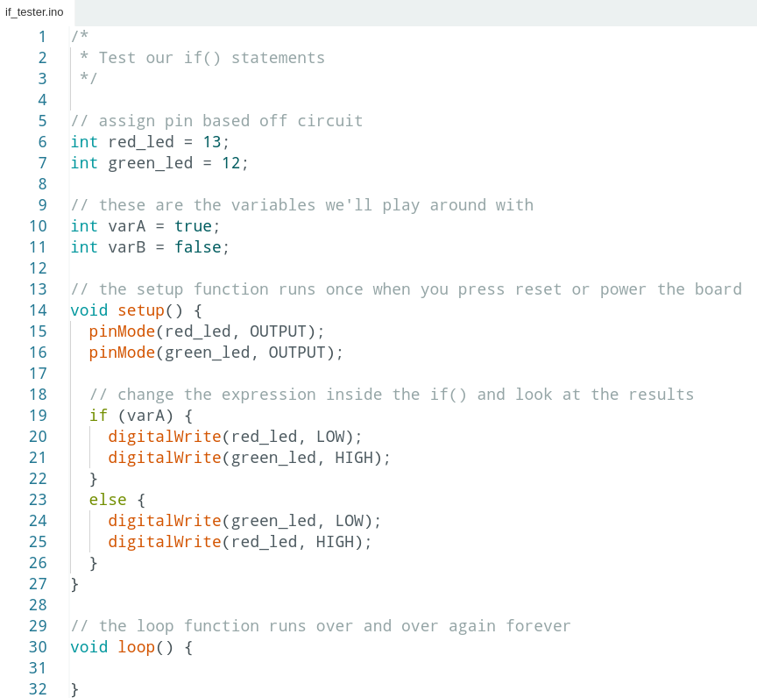

Project #3 – Lie Detector Code Review
1 | /*
2 | * Test our if() statements
3 | */
4
5 | // assign pin based off circuit
6 | int red_led = 13;
7 | int green_led = 12;
8
9 | // these are the variables we'll play around with
10 | int a = true;
11 | int b = false;
12
13 | // the setup function runs once when you press reset or power the board
14 | void setup() {
15 | pinMode(red_led, OUTPUT);
16 | pinMode(green_led, OUTPUT);
17
18 | // change the expression inside the if() and look at the results
19 | if (a) {
20 | digitalWrite(red_led, LOW);
21 | digitalWrite(green_led, HIGH);
22 | }
23 | else {
24 | digitalWrite(green_led, LOW);
25 | digitalWrite(red_led, HIGH);
26 | }
27 | }
28
29 | // the loop function runs over and over again forever
30 | void loop() {
31
32 | }

Slide 29
Project #3 – Lie Detector Code Review
1 | /*
2 | * Test our if() statements
3 | */
4
5 | // assign pin based off circuit
6 | int red_led = 13;
7 | int green_led = 12;
8
9 | // these are the variables we'll play around with
10 | int a = true;
11 | int b = false;
12
13 | // the setup function runs once when you press reset or power the board
14 | void setup() {
15 | pinMode(red_led, OUTPUT);
16 | pinMode(green_led, OUTPUT);
17
18 | // change the expression inside the if() and look at the results
19 | if (b) {
20 | digitalWrite(red_led, LOW);
21 | digitalWrite(green_led, HIGH);
22 | }
23 | else {
24 | digitalWrite(green_led, LOW);
25 | digitalWrite(red_led, HIGH);
26 | }
27 | }
28
29 | // the loop function runs over and over again forever
30 | void loop() {
31
32 | }

Slide 30
Project #3 – Lie Detector Code Review
1 | /*
2 | * Test our if() statements
3 | */
4
5 | // assign pin based off circuit
6 | int red_led = 13;
7 | int green_led = 12;
8
9 | // these are the variables we'll play around with
10 | int a = true;
11 | int b = false;
12
13 | // the setup function runs once when you press reset or power the board
14 | void setup() {
15 | pinMode(red_led, OUTPUT);
16 | pinMode(green_led, OUTPUT);
17
18 | // change the expression inside the if() and look at the results
19 | if (!b) {
20 | digitalWrite(red_led, LOW);
21 | digitalWrite(green_led, HIGH);
22 | }
23 | else {
24 | digitalWrite(green_led, LOW);
25 | digitalWrite(red_led, HIGH);
26 | }
27 | }
28
29 | // the loop function runs over and over again forever
30 | void loop() {
31
32 | }

Slide 31
Project #3 – Lie Detector Code Review
1 | /*
2 | * Test our if() statements
3 | */
4
5 | // assign pin based off circuit
6 | int red_led = 13;
7 | int green_led = 12;
8
9 | // these are the variables we'll play around with
10 | int a = true;
11 | int b = false;
12
13 | // the setup function runs once when you press reset or power the board
14 | void setup() {
15 | pinMode(red_led, OUTPUT);
16 | pinMode(green_led, OUTPUT);
17
18 | // change the expression inside the if() and look at the results
19 | if (!a) {
20 | digitalWrite(red_led, LOW);
21 | digitalWrite(green_led, HIGH);
22 | }
23 | else {
24 | digitalWrite(green_led, LOW);
25 | digitalWrite(red_led, HIGH);
26 | }
27 | }
28
29 | // the loop function runs over and over again forever
30 | void loop() {
31
32 | }

Slide 32
Project #3 – Lie Detector Code Review
1 | /*
2 | * Test our if() statements
3 | */
4
5 | // assign pin based off circuit
6 | int red_led = 13;
7 | int green_led = 12;
8
9 | // these are the variables we'll play around with
10 | int a = 9;
11 | int b = 5;
12
13 | // the setup function runs once when you press reset or power the board
14 | void setup() {
15 | pinMode(red_led, OUTPUT);
16 | pinMode(green_led, OUTPUT);
17
18 | // change the expression inside the if() and look at the results
19 | if (a > b) {
20 | digitalWrite(red_led, LOW);
21 | digitalWrite(green_led, HIGH);
22 | }
23 | else {
24 | digitalWrite(green_led, LOW);
25 | digitalWrite(red_led, HIGH);
26 | }
27 | }
28
29 | // the loop function runs over and over again forever
30 | void loop() {
31
32 | }

Slide 33
Project #3 – Lie Detector Code Review
1 | /*
2 | * Test our if() statements
3 | */
4
5 | // assign pin based off circuit
6 | int red_led = 13;
7 | int green_led = 12;
8
9 | // these are the variables we'll play around with
10 | int a = 9;
11 | int b = 5;
12
13 | // the setup function runs once when you press reset or power the board
14 | void setup() {
15 | pinMode(red_led, OUTPUT);
16 | pinMode(green_led, OUTPUT);
17
18 | // change the expression inside the if() and look at the results
19 | if (a < b) {
20 | digitalWrite(red_led, LOW);
21 | digitalWrite(green_led, HIGH);
22 | }
23 | else {
24 | digitalWrite(green_led, LOW);
25 | digitalWrite(red_led, HIGH);
26 | }
27 | }
28
29 | // the loop function runs over and over again forever
30 | void loop() {
31
32 | }

Slide 34
Project #3 – Lie Detector Code Review
1 | /*
2 | * Test our if() statements
3 | */
4
5 | // assign pin based off circuit
6 | int red_led = 13;
7 | int green_led = 12;
8
9 | // these are the variables we'll play around with
10 | int a = true;
11 | int b = 5;
12
13 | // the setup function runs once when you press reset or power the board
14 | void setup() {
15 | pinMode(red_led, OUTPUT);
16 | pinMode(green_led, OUTPUT);
17
18 | // change the expression inside the if() and look at the results
19 | if (b > 5 || a) {
20 | digitalWrite(red_led, LOW);
21 | digitalWrite(green_led, HIGH);
22 | }
23 | else {
24 | digitalWrite(green_led, LOW);
25 | digitalWrite(red_led, HIGH);
26 | }
27 | }
28
29 | // the loop function runs over and over again forever
30 | void loop() {
31
32 | }

Slide 35
Project #3 – Lie Detector Code Review
1 | /*
2 | * Test our if() statements
3 | */
4
5 | // assign pin based off circuit
6 | int red_led = 13;
7 | int green_led = 12;
8
9 | // these are the variables we'll play around with
10 | int a = true;
11 | int b = 5;
12
13 | // the setup function runs once when you press reset or power the board
14 | void setup() {
15 | pinMode(red_led, OUTPUT);
16 | pinMode(green_led, OUTPUT);
17
18 | // change the expression inside the if() and look at the results
19 | if (b > 5 && a) {
20 | digitalWrite(red_led, LOW);
21 | digitalWrite(green_led, HIGH);
22 | }
23 | else {
24 | digitalWrite(green_led, LOW);
25 | digitalWrite(red_led, HIGH);
26 | }
27 | }
28
29 | // the loop function runs over and over again forever
30 | void loop() {
31
32 | }

Slide 36
Project #3 – Lie Detector Code Review
1 | /*
2 | * Test our if() statements
3 | */
4
5 | // assign pin based off circuit
6 | int red_led = 13;
7 | int green_led = 12;
8
9 | // these are the variables we'll play around with
10 | int a = true;
11 | int b = 5;
12
13 | // the setup function runs once when you press reset or power the board
14 | void setup() {
15 | pinMode(red_led, OUTPUT);
16 | pinMode(green_led, OUTPUT);
17
18 | // change the expression inside the if() and look at the results
19 | if (b >= 5 && a) {
20 | digitalWrite(red_led, LOW);
21 | digitalWrite(green_led, HIGH);
22 | }
23 | else {
24 | digitalWrite(green_led, LOW);
25 | digitalWrite(red_led, HIGH);
26 | }
27 | }
28
29 | // the loop function runs over and over again forever
30 | void loop() {
31
32 | }

Slide 37
Boolean Operators
<Boolean> | True if:
(a) | a is true, HIGH or does not equal zero
(!a) | a is false, LOW or equals zero
(a) == (b) | a is equal to b
(a) != (b) | a is not equal to b
(a) > (b) | a is greater than b
(a) >= (b) | a is greater than or equal to b
(a) < (b) | a is less than b
(a) <= (b) | a is less than or equal to b
(a) && (b) | both a is true AND b is true
(a) || (b) | either a is true OR b is true

Slide 38
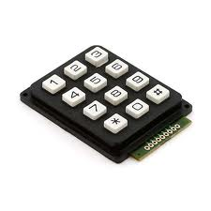
digitalRead()
Project #4 – Button/Maintained Switch Switch
Who you callin’ momentary?
Psuedo-code – how should this work?
LED turns off
Button Pressed?
LED
status?
ON
Rinse & Repeat
YES
OFF
LED turns on

Slide 39
digitalRead()
Project #4 – Button/Maintained Switch Switch
Who you callin’ momentary?
Psuedo-code – how should this work?
LED turns off
Button Pressed?
Pressed Before?
LED
status?
ON
Rinse & Repeat
YES
NO
OFF
LED turns on

Slide 40
Project #4 – Button/Maintained Switch Switch Inputs and Outputs
LED turns off
Button Pressed?
Pressed Before?
LED
status?
ON
Rinse & Repeat
YES
NO
OFF
LED turns on
Inputs | Outputs
Push Button | LED
Notes:
Our program is running hundreds of thousands of times every second

Slide 41
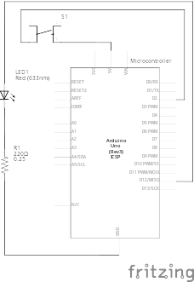
Transitioning to Micro-control Output & Input

Slide 42
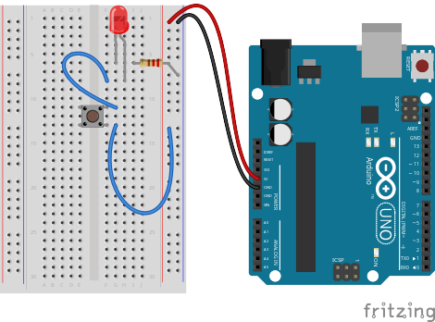
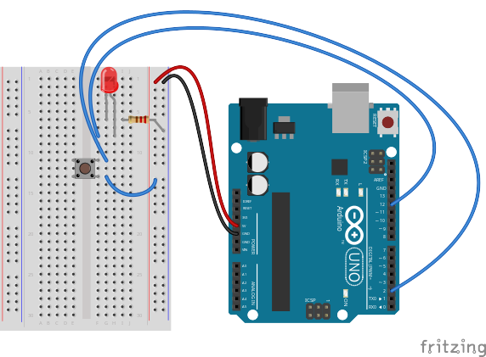
Transitioning to Micro-control Output & Input

Slide 43
Project #4 – Button/Maintained Switch Switch Wiring Diagram

Slide 44
Project #4 – Button/Maintained Switch Switch Wiring Diagram
WRONG!!!

Slide 45
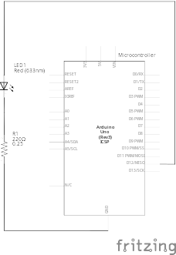
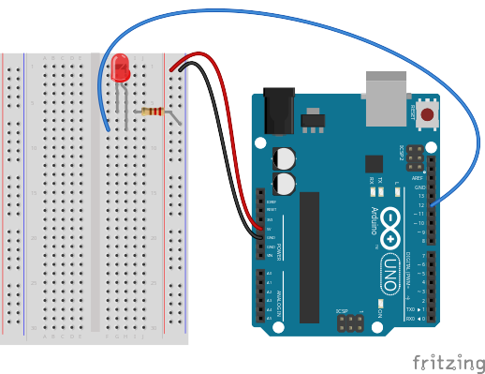
This Part Is Good

Slide 46
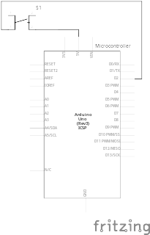
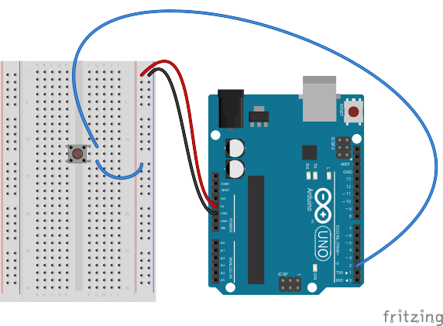
So This Must Be Bad…

Slide 47
So This Must Be Bad…
But Why?!

Slide 48
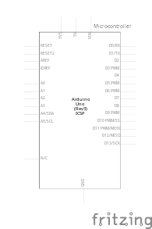

Another Water Analogy

Slide 49
Analogy Continued...

Slide 50
Analogy Continued...
?

Slide 51

All Stopped Up

Slide 52

All Stopped Up (kinda)

Slide 53
Switch Off

Slide 54

Switch On

Slide 55

Switch Off?!

Slide 56

Analogy Extended (Thin but holding)

Slide 57
So This Approach...

Slide 58
Doesn’t Work!

Slide 59
What About...

Slide 60
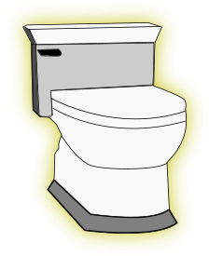
Changing Bathroom Fixtures?

Slide 61


Slide 62
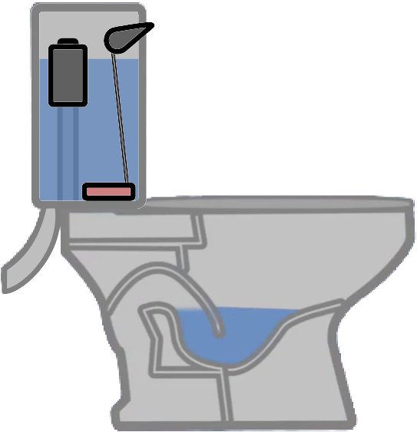

Getting Rid of the Unnecessary Crap

Slide 63
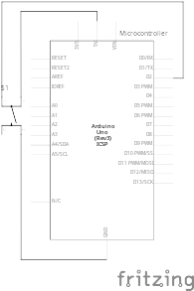
Changing the Viewpoint

Slide 64
Changing the Viewpoint

Slide 65
Changing the Viewpoint

Slide 66
Changing the Viewpoint

Slide 67
Switch Off

Slide 68

Switch On

Slide 69

Switch Right After Off

Slide 70
Switch Off

Slide 71
Stop Playin’ With the Commode!!

Slide 72

Possible Solution

Slide 73
How Do We Get Here?
?

Slide 74




Resistance Analogy
Water
Tower
Water
Tower
V
Big Pipe == Lower Resistance
Small Pipe == Higher Resistance

Slide 75
How Do We Get Here?
?

Slide 76
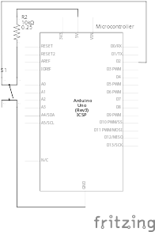
The Pull-Up Resistor!

Slide 77
But There’s A Trade-Off Between This...

Slide 78
…And This

Slide 79
It’s All About Compromise
10kΩ is a good value
(brown-black-black-red-gold)
or
(brown-black-orange-gold)

Slide 80
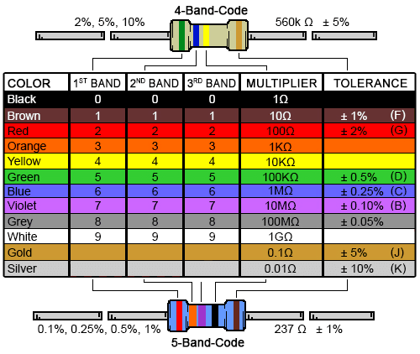
Decoding Resistor Values

Slide 81
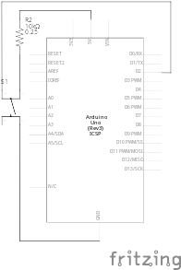
Project #4 – Button/Maintained Switch Switch Input Schematic
Schematic of Pull-Up Resistor and Switch

Slide 82
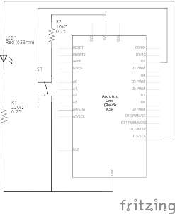
Project #4 – Button/Maintained Switch Switch Full Schematic
And the output is still the same as Project 1!

Slide 83
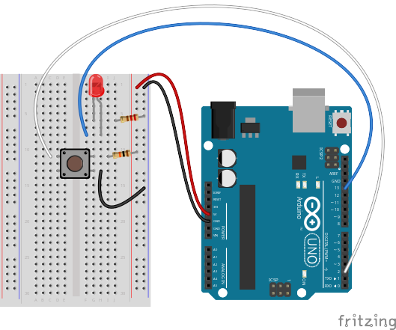
Project #4 – Button/Maintained Switch Switch Wiring Diagram

Slide 84
Project #4 – Button/Maintained Switch Switch Our First Input Commands!
pinMode(pin, INPUT/OUTPUT);
Notes:
Three commands to rule the world… or at least do 80% of cool Arduino projects.

Slide 85
Project #4 – Button/Maintained Switch Switch Our First Input Commands!
pinMode(pin, INPUT/OUTPUT);
ex: pinMode(2, INPUT);
Notes:
Three commands to rule the world… or at least do 80% of cool Arduino projects.

Slide 86
Project #4 – Button/Maintained Switch Switch Our First Input Commands!
pinMode(pin, INPUT/OUTPUT);
ex: pinMode(2, INPUT);
digitalRead(pin);
Notes:
Three commands to rule the world… or at least do 80% of cool Arduino projects.

Slide 87
Project #4 – Button/Maintained Switch Switch Our First Input Commands!
pinMode(pin, INPUT/OUTPUT);
ex: pinMode(2, INPUT);
digitalRead(pin);
ex: digitalRead(2);
Notes:
Three commands to rule the world… or at least do 80% of cool Arduino projects.

Slide 88
Project #4 – Button/Maintained Switch Switch Our First Input Commands!
pinMode(pin, INPUT/OUTPUT);
ex: pinMode(2, INPUT);
digitalRead(pin);
ex: digitalRead(2);
ex: int button_state = digitalRead(2);
Notes:
Three commands to rule the world… or at least do 80% of cool Arduino projects.

Slide 89
Project #4 – Button/Maintained Switch Switch Our First Input Commands!
pinMode(pin, INPUT/OUTPUT);
ex: pinMode(2, INPUT);
digitalRead(pin);
ex: digitalRead(2);
ex: int button_state = digitalRead(2);
button_state will either be HIGH or LOW
HIGH if switch is off, LOW if switch is on
Notes:
Three commands to rule the world… or at least do 80% of cool Arduino projects.

Slide 90
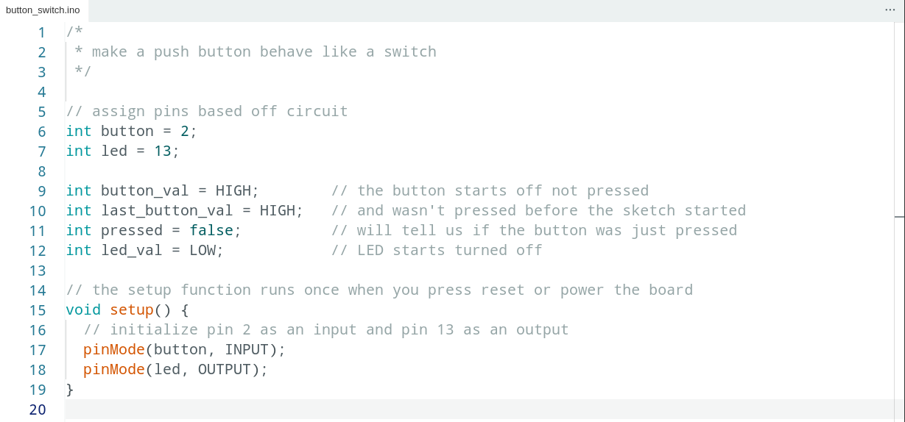
Project #4 – Button/Maintained Switch Switch Code Review

Slide 91
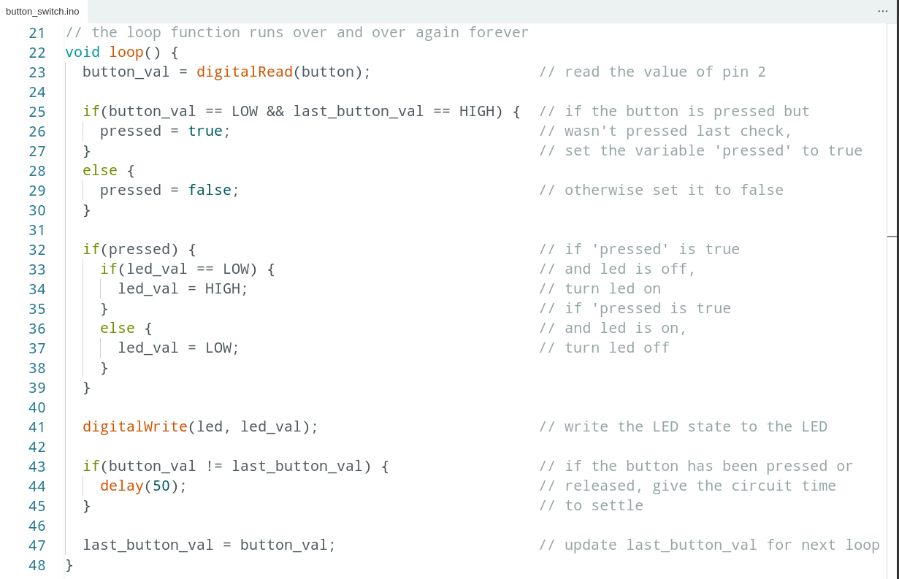
Code Review Continued

Slide 92


Code Review Continued

Slide 93
Project #4 – Button/Maintained Switch Switch Puzzles
Challenge 4a – Wire another LED. Make the button turn one off and the other on
Challenge 4b – Make an LED blink when you press the button (hint: look at File>Examples>Digital>Blink Without Delay)
Challenge 4c – Make an LED alternate between off, on and blink by pressing the button

Slide 94

analogRead()
Project #4 – Night Light
How Dark Is Too Dark?
Psuedo-code – how should this work?
LED turns on
TOO DARK!
Check How Dark It Is
How Dark Is It?
Rinse & Repeat
IT’S FINE
LED turns off

Slide 95
Project #4 - Night Light Inputs and Outputs
LED turns on
TOO DARK!
Check How Dark It Is
How Dark Is It?
Rinse & Repeat
IT’S FINE
LED turns off
Inputs | Outputs
Photoresistor | LED

Slide 96


The Voltage Divider

Slide 97

The Voltage Divider

Slide 98

The Voltage Divider
“From each according to their ability, to each according to their need.”

Slide 99

The Voltage Divider
How many carrots does the fairy have left at this point?

Slide 100

The Voltage Divider
How many carrots does the fairy have left at this point?

Slide 101

The Voltage Divider
How many carrots does the fairy have left at this point?

Slide 102

The Voltage Divider
How many carrots does the fairy have left at this point?

Slide 103

The Voltage Divider
How many carrots does the fairy have left at this point?

Slide 104

The Switch-Over

Slide 105

Project #4 – Night Light Schematic

Slide 106

Project #4 – Night Light Wiring Diagram

Slide 107

Project #4 – Night Light
int sensor_val = analogRead(pin);
pin – refers to the analog input pin (limited to pins A0, A1, A2, A3, A4 and A5)
Arduino uses a 10-bit analog-to-digital converter (ADC):
This means that sensor_val is always a number between 0 and 1023
Minimum Carrots → 0
Maximum Carrots → 1023

Slide 108
Determining Analog Values
But the top bunny is always going to get some carrots, so we can’t really get to 1023
And we can’t really make our bottom bunny so small that it gets 0 carrots
So how do we determine the minimum and maximum numbers for our circuit?
Do math

Slide 109
Determining Analog Values
But the top bunny is always going to get some carrots, so we can’t really get to 1023
And we can’t really make our bottom bunny so small that it gets 0 carrots
So how do we determine the minimum and maximum numbers for our circuit?
Do math
Ask the microcontroller

Slide 110




Using Serial Communication
Method used to transfer data between two devices.
Data passes between the computer and Arduino through the Universal Serial Bus (USB!) cable. Data is transmitted as zeros (‘0’) and ones (‘1’) sequentially.
Arduino dedicates Digital I/O pin # 0 to receiving and Digital I/O pin #1 to transmit.
Notes:
Serial is the same for novels, soldiers, murders, killers, communication
For this reason, we typically do not use Digital I/O 0 or 1 for anything in our designs.

Slide 111

Displaying the Serial Monitor

Slide 112

A Tour of the Serial Monitor

Slide 113

A Tour of the Serial Monitor

Slide 114

A Tour of the Serial Monitor

Slide 115

A Tour of the Serial Monitor

Slide 116

A Tour of the Serial Monitor

Slide 117

A Tour of the Serial Monitor

Slide 118


Baud Rate
How do we know how many 0’s and 1’s there are?
We tell how the computer and microcontroller how long a signal has to be high or low to count as a 1 or a 0 by setting the baud rate
For our purposes it doesn’t really matter what the baud rate is, it’s just important that the microcontroller and computer agree!

Slide 119
Serial Commands
Serial.begin(baud_rate);
ex: Serial.begin(9600);
Serial.print(“Text”);
Serial.print(variable);
Serial.println(“Text”);
Serial.println(variable);

Slide 120

Ask Arduino - Code Review

Slide 121

Serial Communication: Serial Debugging
void loop()
{
int xVar = 10;
Serial.print ( “Variable xVar is “ ) ;
Serial.println ( xVar ) ;
}

Slide 122

Serial Communication: Serial Troubleshooting
void loop ( )
{
Serial.print (“Digital pin 9: “);
Serial.println (digitalRead(9));
}

Slide 123

Night Light - Code Review

Slide 124
Analog Sensors
Examples:
Sensors | Variables
Photoresistor | light_level
Microphone | sound_volume
Temp Sensor | temp
Flex Sensor | bend
Accelerometer | tilt, acceleration

Slide 125

Trimpot (Potentiometer) Variable Resistor
fixed
end
wiper
fixed
end

Slide 126

Trimpot (Potentiometer) Variable Resistor

Slide 127
Trimpot (Potentiometer) What does it mean?
Since we’re controlling the size of both bunnies:
We can make either bunny so small it gets zero carrots
We get the full range of 0-1023!
This makes potentiometers excellent controllers for physical computing “settings”
Can we think of any examples?
But what if the setting we want to control has less (or more) than 1023 values? Or if we want it not to start at 0?
Do math

Slide 128
Trimpot (Potentiometer) What does it mean?
Since we’re controlling the size of both bunnies:
We can make either bunny so small it gets zero carrots
We get the full range of 0-1023!
This makes potentiometers excellent controllers for physical computing “settings”
Can we think of any examples?
But what if the setting we want to control has less (or more) than 1023 values? Or if we want it not to start at 0?
Do math
Get the microcontroller to do it for us

Slide 129
Map Command
int new_var = map(old_var, old_low, old_high, new_low, new_high);
ex: offset_val = map(val, 0, 100, -50, 50);
ex: reverse_val = map(val, 1, 100, 100, 1);
ex: write_val = map(read_val, 0, 1023, 0, 255);

Slide 130
Project #5 – Real Time Color Mixer
Tying it all together...
Psuedo-code – how should this work?
Change to green
Light green LED
RED
Button A Pressed?
Pressed Before?
Current LED?
Change to blue
Light yellow LED
YES
NO
GREEN
BLUE
Change to red
Light red LED
Write a scaled trimpot value to red pin of RGB LED
RED
Button B Pressed?
Read trimpot
Current LED?
Write a scaled trimpot value to green pin of RGB LED
YES
GREEN
BLUE
Write a scaled trimpot value to blue pin of RGB LED

Slide 131
Project #5 – Inputs and Outputs
Inputs | Outputs
a “Select” Button | Red Indicator
an “Adjust” Button | Green Indicator
Trimpot | Blue Indicator
 | RGB LED

Slide 132

Project #5 – Real Time Color Mixer Schematic

Slide 133

Project #5 – Real Time Color Mixer Wiring Diagram

Slide 134

Where To Go From Here:

Slide 135


Special Thanks:
www.sparkfun.com
6175 Longbow Drive, Suite 200
Boulder, Colorado 80301

